Slide 1
BUSQOM 1080 Model/Variable Selection I
Fall 2020
Lecture 13
Professor: Michael Hamilton

Slide 2
Lecture Summary
Recap Mult Regr. and heterogenous variable types [5 Mins]
Main topic: Choosing the subset of the features in Mult. Reg!
Forward Step Selection and Backward Step Selection [5 Mins]
Best Subset Selection [15 Mins]
Best Subset Selection in R [10 Mins]
Problems with variable selection methods [5 Mins]

Slide 3
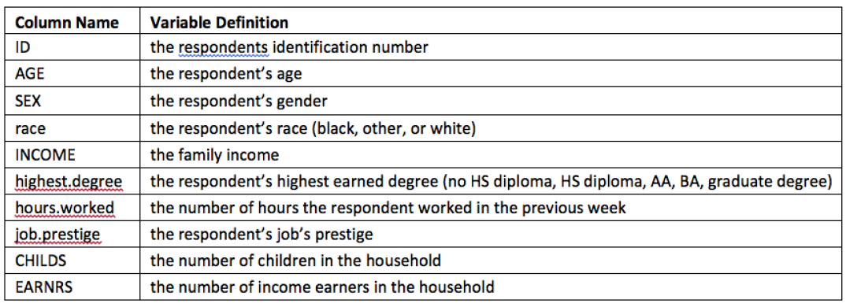
Data for lecture
Save exam2016.txt in your working directory
exam2 =read.table(” Midterm2016.txt ", sep = "\t", header = T)
396 obs in 2008 General Social Survey data
In assignment 6,7

Slide 4
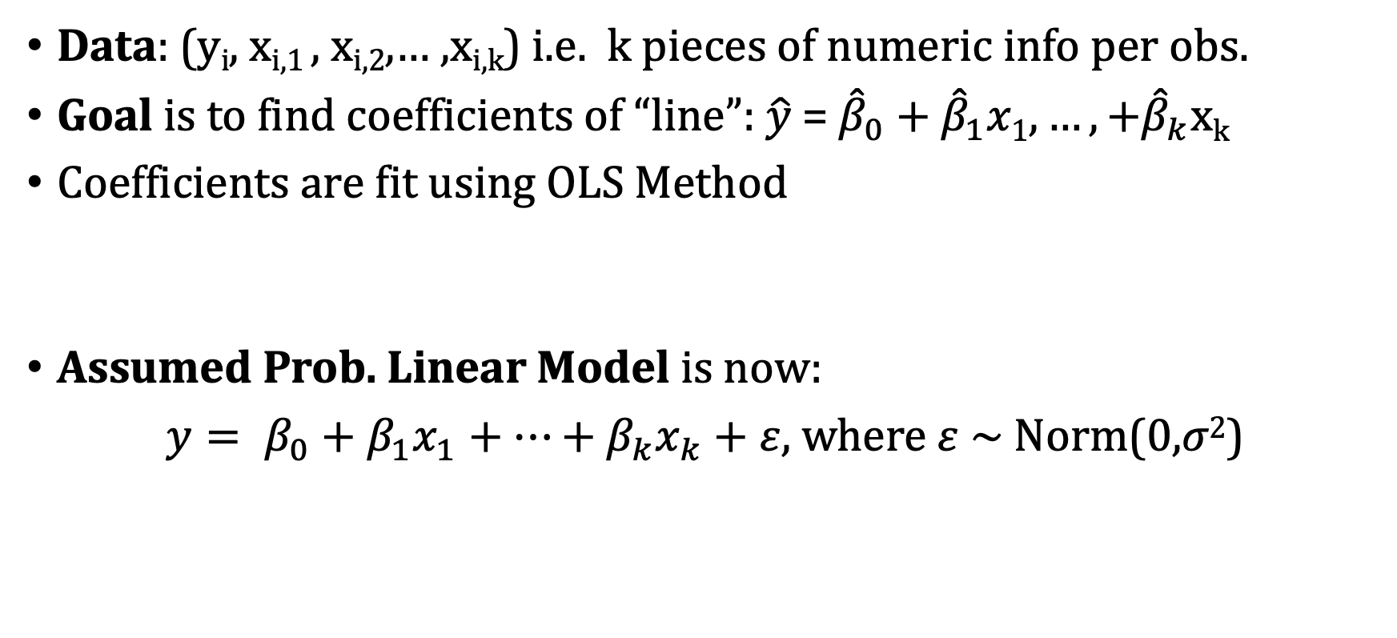
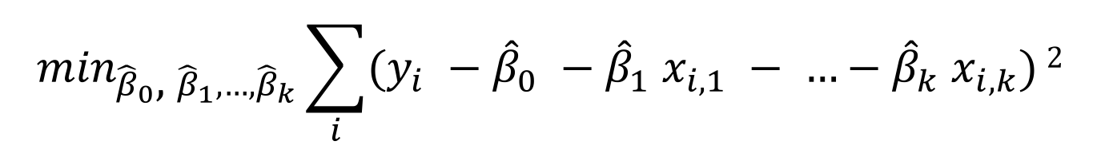
Review: Multiple Linear Regression
Data: (y_{i}, x_{i,1} , x_{i,2},… ,x_{i,k}) i.e. k pieces of numeric info per obs.
Goal is to find coefficients of “line”: $\hat{y}$ = ${\hat{β}}_{0}\text{ +} {\hat{β}}_{1}x1, …,+{\hat{β}}_{k}$x_{k}
Coefficients are fit using OLS Method
Assumed Prob. Linear Model is now:
$y= β_{0}+β_{1}x_{1}+…+β_{k}x_{k}+ε,$ where $ε$ ~ Norm(0,$σ2$)
$\min_{{\hat{β}}_{0}\text{, }{\hat{β}}_{1}, …,{\hat{β}}_{k}}\sum_{i}{(y_{i} −{\hat{β}}_{0} −{\hat{β}}_{1} x_{i,1} − …−{\hat{β}}_{k} x_{i,k})}$²

Slide 5
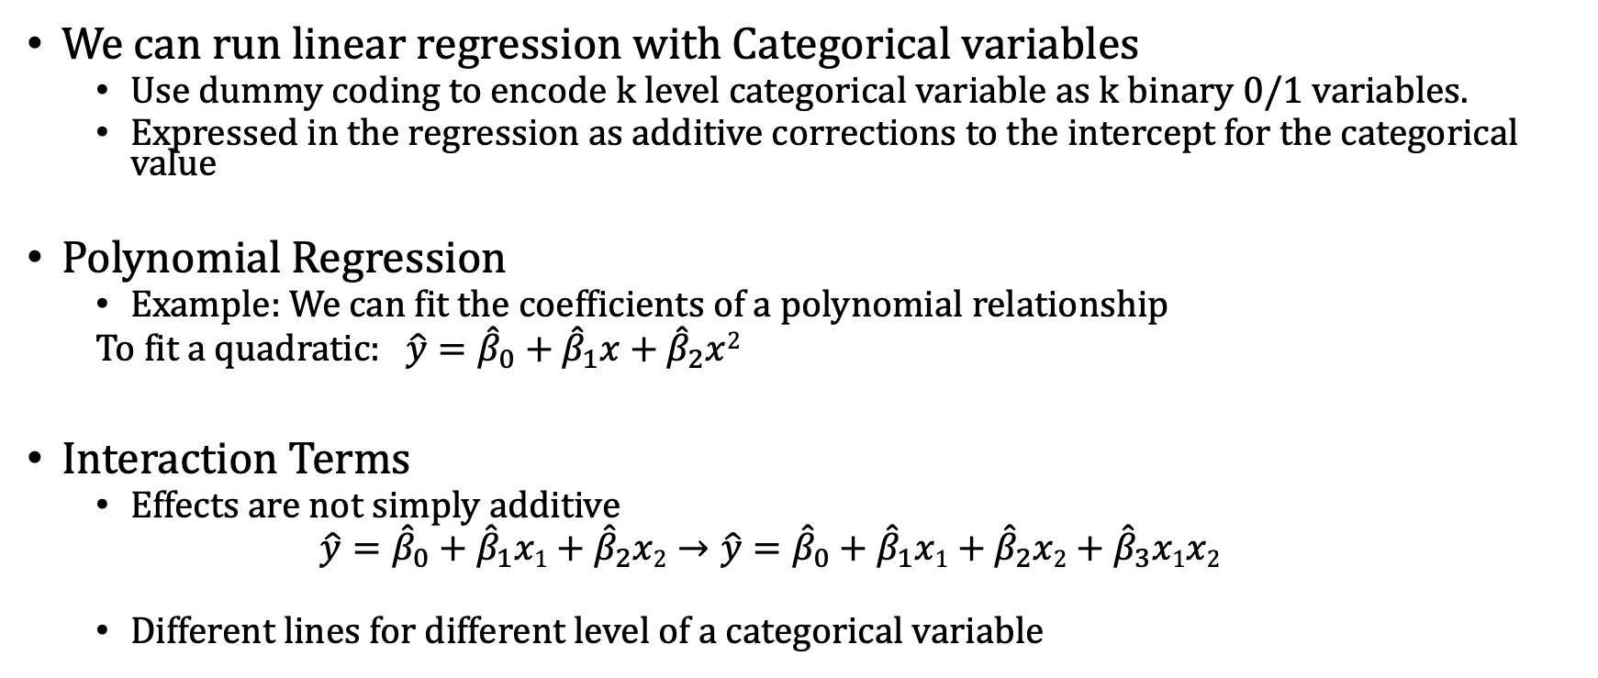
Review: Heterogeneous Variable Types
We can run linear regression with Categorical variables
Use dummy coding to encode k level categorical variable as k binary 0/1 variables.
Expressed in the regression as additive corrections to the intercept for the categorical value
Polynomial Regression
Example: We can fit the coefficients of a polynomial relationship
To fit a quadratic: $\hat{y}={\hat{β}}_{0}+{\hat{β}}_{1}x+{\hat{β}}_{2}x$²
Interaction Terms
Effects are not simply additive
$$\hat{y}={\hat{β}}_{0}+{\hat{β}}_{1}x1+{\hat{β}}_{2}x2→\hat{y}={\hat{β}}_{0}+{\hat{β}}_{1}x1+{\hat{β}}_{2}x2+{\hat{β}}_{3}x1x2$$
Different lines for different level of a categorical variable
New variable, simply the square of the x
New variable, product of x and y

Slide 6
Review: Dummy Coding with >2 Categories
Idea: Code the categories as 1, 2, 3, 4
Problem: These numeric numbers impact how it affects the regression equation! i.e. if we code a category as 4, its appear has 4 times the impact of category 1
Solution: Use a set of binary (0/1) variables to identify different groups
Example: Insurance Type (payment method)
Groups: Commercial, Medicare, Medicaid, Self-Pay, Other
Choose a reference group that will get absorbed into intercept
For remaining groups, create binary variable (1 if in that group, 0 otherwise)
Always have 1 fewer dummy variables than groups in your Regression model
Each group has a different intercept
The “slope” for each dummy variable signifies the difference between its intercept and the reference group’s intercept

Slide 7
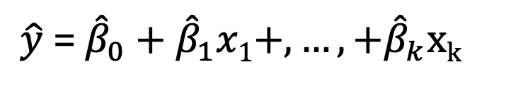
Topic: Model Selection in Mult. Regr.
$\hat{y}$ = ${\hat{β}}_{0}\text{ +} {\hat{β}}_{1}x1+, …,+{\hat{β}}_{k}$x_{k}
Problem: Often, after including all the terms we can think to add into our regression, we’re left with a model with many many feature variables, many of which are not helpful!
These make the model confusing to analyze
They can hurt the models adjusted R²
Can lead to overfitting and thus poor out of sample performance
Goal: Come up with methods to select the best subset of the feature variables
Smaller is better for regression models!
There are many weird interactions when we add and remove variables
Previously insignificant vars become significant and vice versa!

Slide 8
Topic: Model Selection in Mult. Regr.
$\hat{y}$ = ${\hat{β}}_{0}\text{ +} {\hat{β}}_{1}x1+, …,+{\hat{β}}_{k}$x_{k}
Potential Methods:
Personal judgment or preference (i.e. pick vars to remove)
Two-standard-error rule (i.e., looking at p-values, remove insignif.)
Stepwise methods
Typically use Akaike Information Criterion (AIC) to compare models
Smaller AIC ➔ Better model
Best subset method. (enumerative method)
Typically use Bayesian Information Criterion (BIC) to compare models
Smaller BIC ➔ Better model

Slide 9
Two Standard Error Rule for Selection
Two-standard-error rule – Start with full model, then keep only predictors having significant t-tests (the name comes from the critical t-value being about 2)
Warning: Removing multiple variables at the same time is not a good idea in general
Algorithm: Each step, remove variables if any of the p-values for the predictors are greater than significance level.
After removing the variables, rerun your model
Repeat until p-values are all less than significance level, then stop.
Fine, simple method, but crude. Can we be more scientific?

Slide 10
Stepwise Subset Selection Methods
Idea: Build regression models one variable at a time, adding or removing a variable in each step according to some rule.
These are simple computer-run approaches. These rules builds on the previous rule, they’re not optimal but are often used in practice
Forward Step: Start with no variables, then add predictors one at a time, each time picking the best available, until none of the remaining predictors improve your model.
Backward Step: Start with all the variables, then remove predictors one at a time, each time removing the poorest available, until all remaining predictors are significant

Slide 11
Best-Subset Selection Method
Idea: If you have N possible predictors, then there are 2^{N} possible subsets of those predictors each corresponding to a different model. If N < 15, this is only a couple thousand models, R can check them all!
A slightly less simple computer-run approach, requires massive computation but is easy to use for the models we’ll see in this class and is “optimal” in the sense of maximizing your criterion
Algorithm: Try every possible subset of predictors and pick the best one according to some criterion
Possible criteria: We could use something like Adjusted R²
There are other criteria that are more commonly used: BIC, AIC

Slide 12
Criteria's for the Subset Selection Model
Akaike Information Criterion (AIC): Information theoretic measure of model quality
AIC = 2k – 2 ln(L(M)) , where k is the size of the model and L(M) is the likelihood of the model
Key point: Like Adjusted R² it captures the trade-off between model size and model performance
Note for AIC smaller means better model!
Bayesian Information Criterion (BIC):
BIC = k ln(n) – 2 ln(L(M)) , where k is the size of the model, n is the number of data points, and L(M) is the likelihood of the model
Key point: Like AIC it captures the trade-off between model size and model performance, higher penalty on larger models under BIC
Note like AIC, for BIC smaller means better model!

Slide 13
Best-Subset Selection Algorithm in Depth
Input: Linear model with N independent variables
Algorithm:
Try every possible subset of predictors, for each subset of predictors run the corresponding linear model and measure the models R²
For size between 2 and N, return the model of that size with best R²
Of the now N-1 models, each of different sizes, choose the model with lowest BIC! That is your selected best subset.

Slide 14
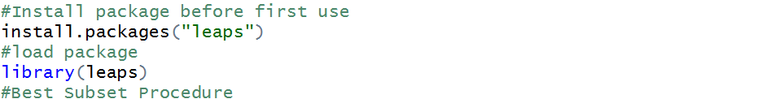
Best-Subset Selection Example in R
Define the full model (just like you would enter it in lm() function, in fact you should copy and paste)
The function regsubsets() picks the best model of each size by R²
Up to you to pick from the different size models. Here BIC is the standard criteria for choosing.

Slide 15

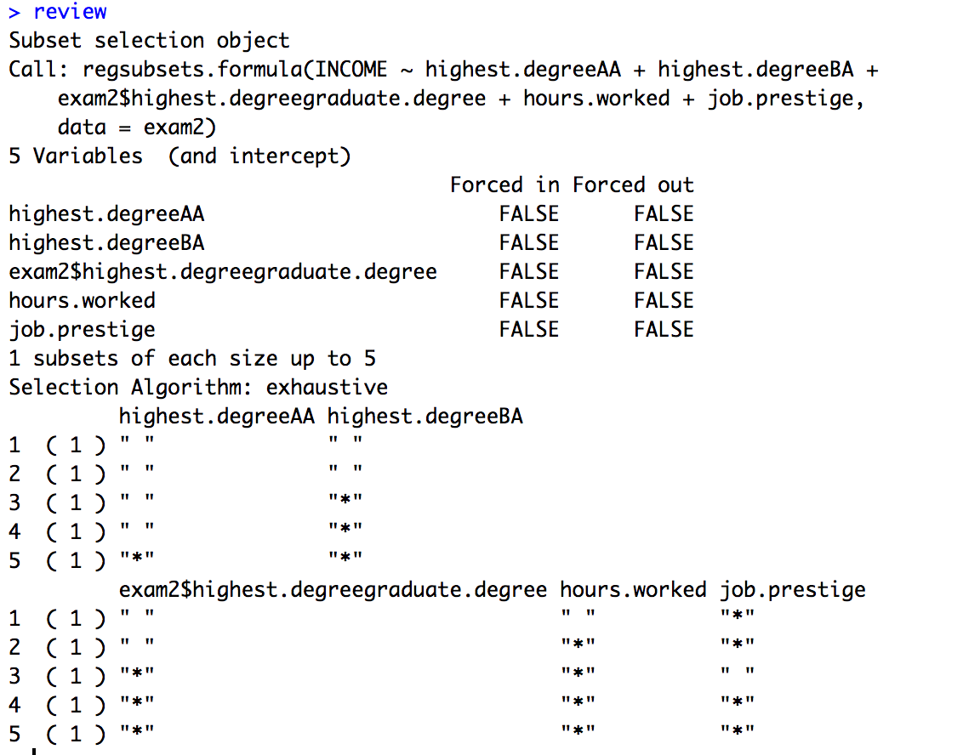
Best-Subset Selection Example in R
Notes:
Returns the best subsets (by R²) for each subset size.
Don’t use for many options (N > 20).
Still need to pick at the end
For each subset size, this shows the best subset.
Example: For size 2, the best model is:
Hours.worked + job.prestige

Slide 16
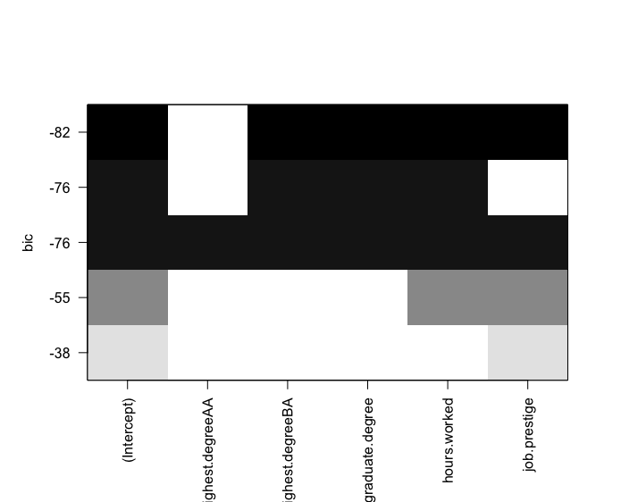
Best-Subset Selection Example in R
Which model to choose? It can be easier to see them by calling >plot(best_model)
x-axis corresponds to each variable (and the intercept)
y-axis shows BIC for each model (row)
Shading shows which variables included in each (darker → smaller BIC)
Best subset (smallest BIC)

Slide 17
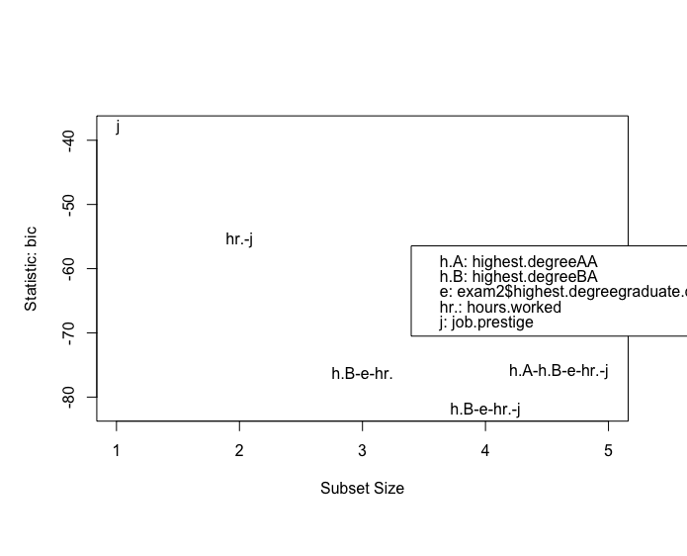

Another way to visualize using subsets()

Slide 18
Topic: Problems with Variable Selection
A classic problem with variable selection is that significance tests like the F test may become invalid
The idea is that since we already tried many different possible models (2^{N}!) and picked the best, thus even at low confidence would be good chance we found some significant model.
We will explore this further in the next lecture
Running time can be a big issue if your model is very large, in these cases you may be forced to default to stepwise selection methods
Often many of the models are nearly identical in performance, making fully optimal models somewhat pointless

Slide 19
Topic: Problems with Variable Selection
Another important question is whether we just want good predictions, or if we want to interpret the model as providing an explanation
The second situation is much harder but also more common
The best model selected may not be the most interpretable
A very common but very serious mistake is to assume that you can tell what variables have a causal influence on the response by looking at which predictors get into the final equation
As we know, we can’t make causal inferences from observed correlation!

